Slide 1


ELECTION RESULT
DATA ANALYSIS
PRESENTED BY: KRISHNA PRAJAPATI

Slide 2
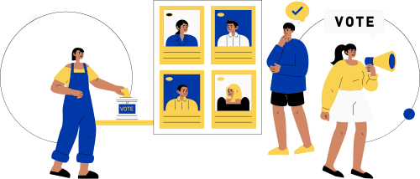

OBJECTIVE
The objective of this task is to analyze the 2024 election data to gain insights into the election results, party performance, and voter trends across various constituencies .
I will use Power BI to
create interactive visualizations and dashboards that will help stakeholders understand the election
outcomes and the dynamics between different political alliances.
04

Slide 3
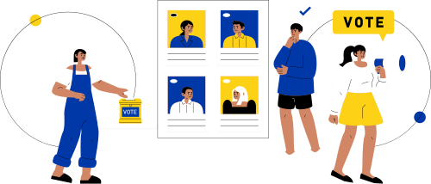
OVERVIEW
1.)Created Card Visuals:
Average Vote Margin: Displays the average difference in votes between the leading and trailing candidates.
Total Number of Seats: Shows the total number of seats contested.
Total States: Indicates the total number of states involved in the election.
2.) Added Slicers:
State: Allows filtering data by specific states.
Constituency: Enables filtering by individual constituencies.
Party Alliance: Facilitates filtering by different party alliances.
3.) Added a Map Visual:
Leading Party by State: Shows the party leading in each state visually on a map.
4.) Added a Table:
Leading Party Alliance by State: Lists the leading party alliances for each state.
Leading Party vs Trailing Party by State: Compares the leading party with the trailing party in each state.

Slide 4

TASK
1. Data Integration:
Combine the election results data with the party alliance data to get a comprehensive view of which
alliances are leading or trailing in various constituencies.
2. Data Cleaning and Preparation:
Ensure data quality by checking for missing values, inconsistencies, and correcting any errors in the datasets.
Create calculated columns or measures if necessary (e.g., percentage margin, win rate).
05

Slide 5
TASK
3. Data Analysis and Visualization:
Overall Results: Create a summary of the overall election results including the total number of seats
won by each party and alliance.
State-wise Analysis: Visualize the performance of leading parties and alliances across different states.
Constituency-wise Analysis: Analyze and visualize the margin of victory/defeat in various
constituencies.
Party and Alliance Comparison: Compare the performance of different parties and their respective
alliances in terms of seats won, margins, and status.
Trend Analysis: Identify and visualize trends in voting patterns, such as regions with high competition (small margins) or dominance by specific parties or alliances.
05

Slide 6
TASK
4. Interactive Dashboard:
Create an interactive dashboard that allows users to filter and explore the data by state, constituency, party, alliance, and status.
Include key performance indicators (KPIs) such as total seats won, average margin, and number of constituencies won by alliance.
5. Insights and Recommendations:
Provide a detailed report summarizing the key insights derived from your analysis.
Offer recommendations based on the data, such as strategies for parties to improve their performance
in future elections.
05

Slide 7

DATA DESCRIPTION
1. Election Results Data:
_id: Unique identifier for each record.
State: Name of the state.
Const. No.: Constituency number.
Constituency: Name of the constituency.
Leading Candidate: Name of the leading candidate.
Leading Party: Name of the leading party.
Trailing Candidate: Name of the trailing candidate.
Trailing Party: Name of the trailing party.
Margin: Vote margin between the leading and trailing candidates.
Status: Status of the election result (e.g., Won, Lost, Leading, Trailing).
07

Slide 8
DATA DESCRIPTION
2. Party Alliance Data:
Party Name: Name of the political party.
Alliance Name: Name of the political alliance the party belongs to.
07

Slide 9
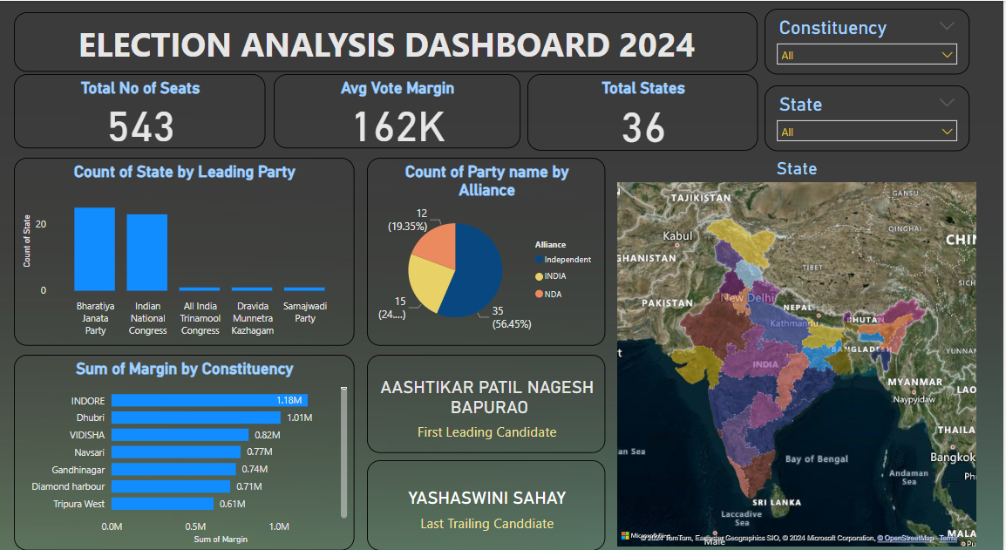
DASHBOARD

Slide 10
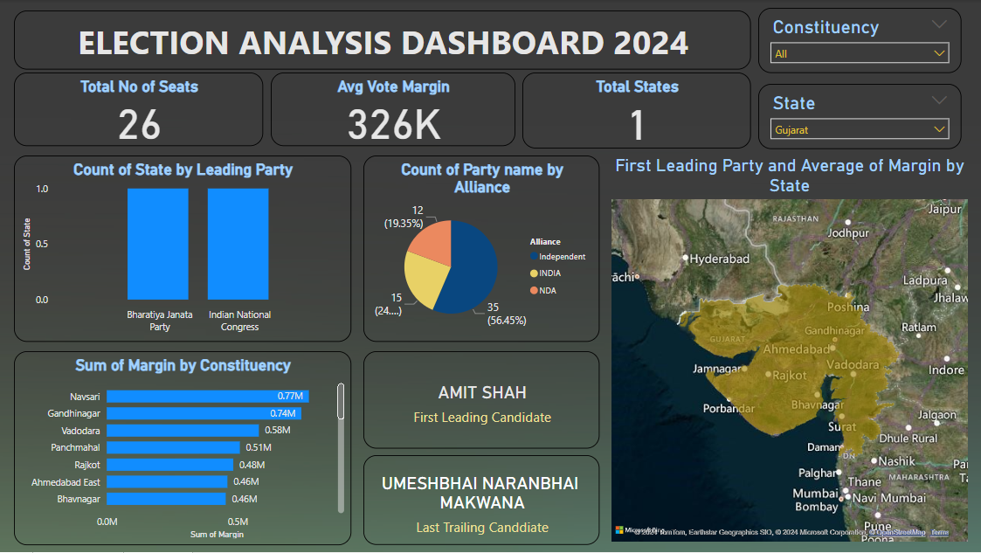
DASHBOARD FILTERED BY STATE

Slide 11
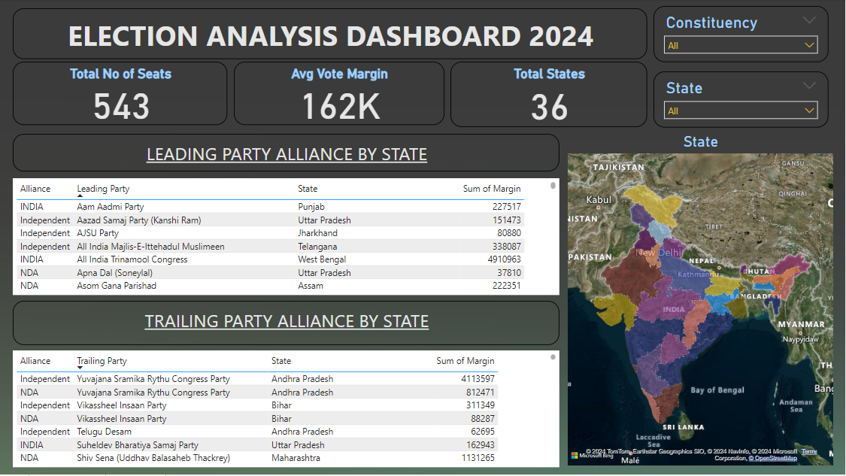
DASHBOARD

Slide 12

RECOMMENDATIONS
1.) Address Critical Issues: Focus on major issues that are
important to voters, such as healthcare, economy, education, and
security. Present clear and actionable plans.
2.) Increase Voter Turnout: Implement strategies to boost voter
turnout, such as better voter registration drives, offering
transportation to polling stations, and encouraging early voting.
3.) Strengthen Ground Game: Build a robust ground campaign with
more volunteers for door-to-door canvassing, phone banking, and
local events to drive voter mobilization.
4.) Collaborate with Influencers: Partner with local influencers,
community leaders, and celebrities to gain endorsements and
amplify campaign messages.
5.) Monitor Opponent Strategies: Keep a close watch on
opponents’ strategies and counteract with timely and effective
responses to any misinformation or negative campaigning.
08

Slide 13
THANK YOU !
10

